Slide 1


Car fault diagnoses mobile app
Final presentation – by group 2

Slide 2
Introduction
Project title: CarCare – Ai based Car Fault Diagnostic System.
Motivation: Many Drivers Struggle to understand dashboard warning lights and engine sound Issues
Objective: Build a mobile App that Uses dashboard images and engine sounds to Diagnose car problems
Key Features: Fault detection, mechanic locator, Feedback System, video Tutorials
Target Users: Car owners, especially non-technical and new unexperienced Drivers

Slide 3
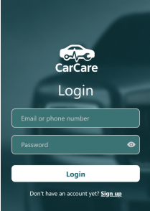
Literature Review
Reviewed existing Diagnostic tools and Mobile Applications
We will begin to look at traditional vehicle diagnostic which rely on manual inspection.
Whie Some Apps offer diagnostic features, it present data that is difficult for non-experts
We exploit if Ai can help by using image recognition to read dashboard warning lights.
Highlighted benefits of Ai in Mobile diagnosis

Slide 4
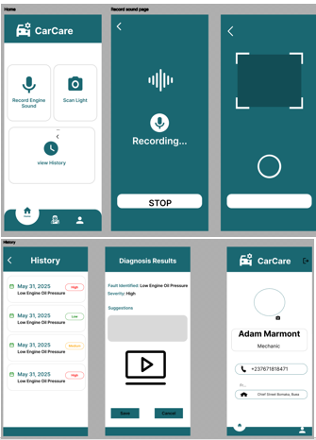
Analysis and Design
Overview
Design Principles
Defined Functional and Non-Functional Requirements.
Presented system Architecture(mobile, Backend, Ai, Database.
Explained Context and data flow diagrams.
Covered use case Diagrams and Sequence Diagrams.
Showed Class and Use Case diagram.
Designed ten teal-themed Ui Screens
Built a Strong Foundation for Implementation

Slide 5
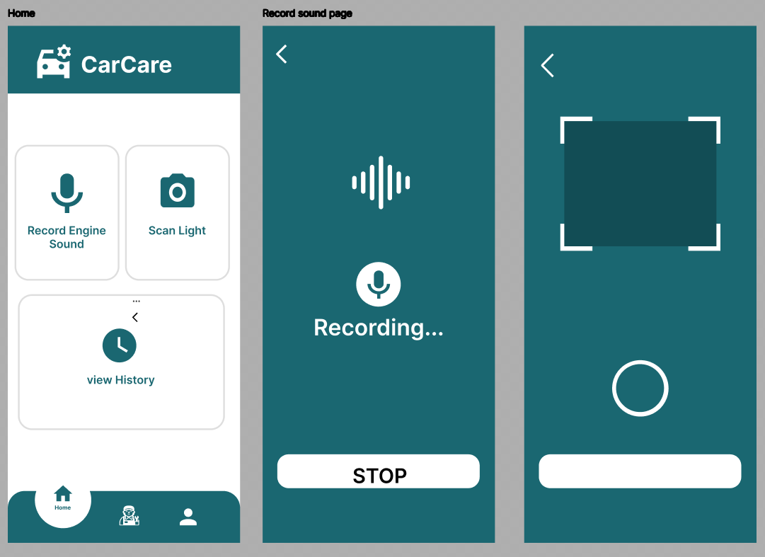
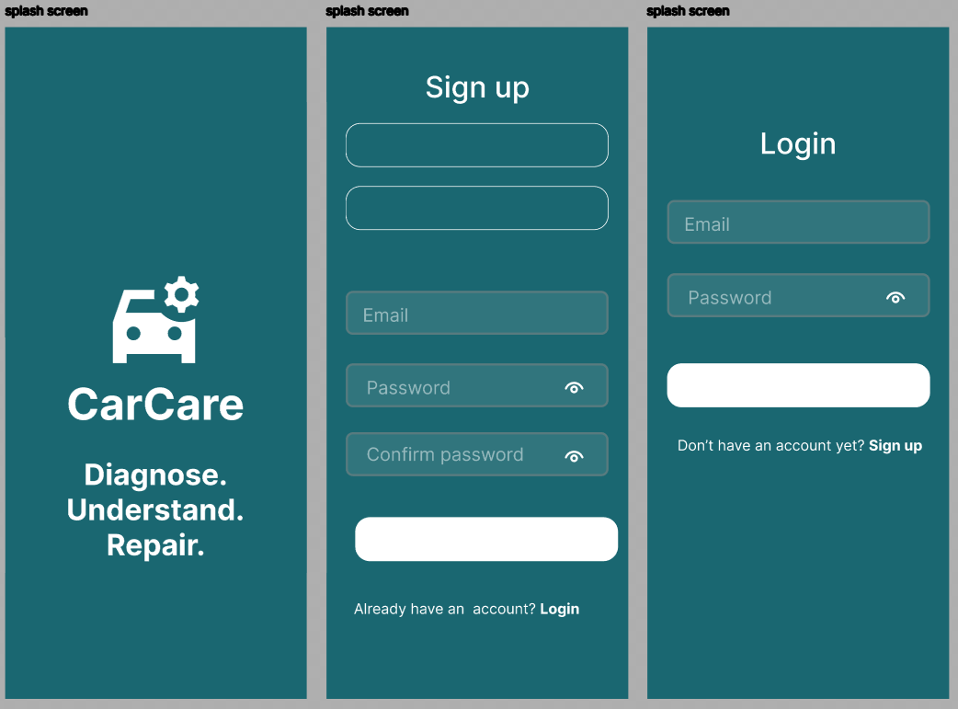
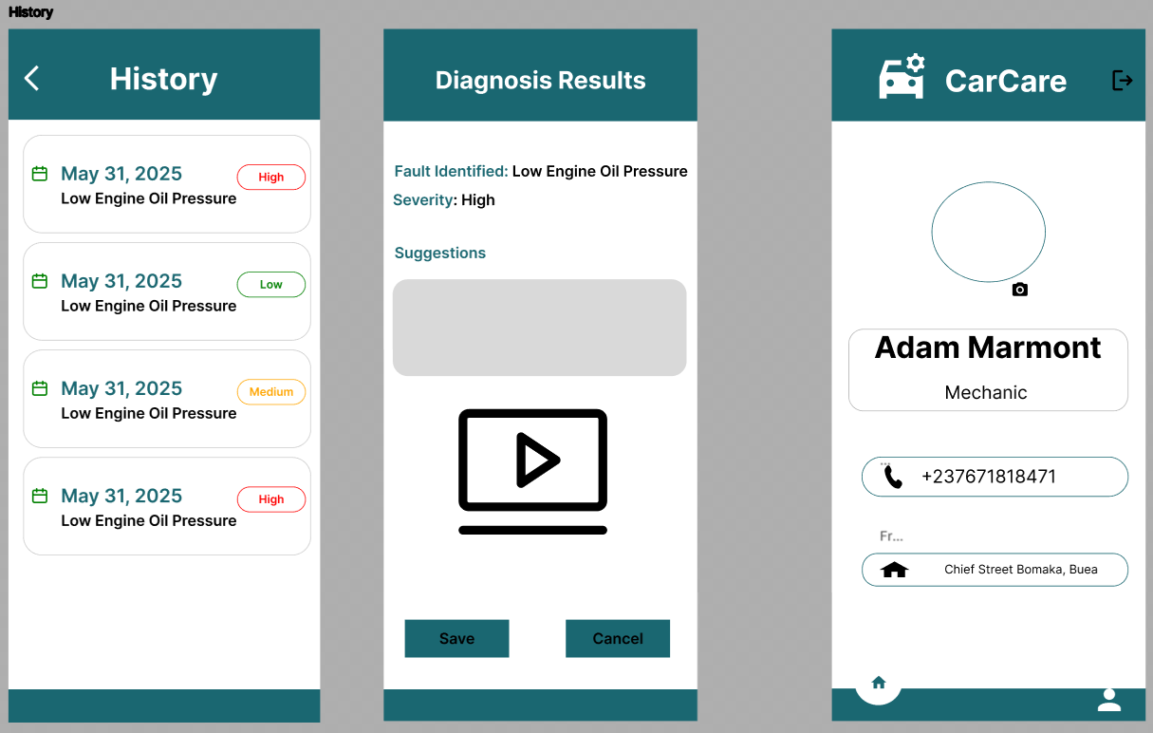

Slide 6
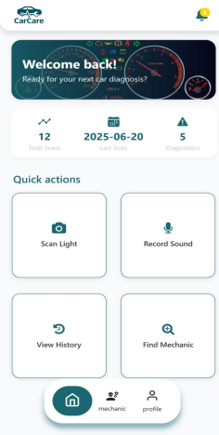



System Implementation & Testing
Technology Stack
React Native
For building native mobile applications with JavaScript and React.
Expo
For cross-platform development, simplifying the build process.
TypeScript
For enhanced code quality and maintainability with static typing.
Node.js connected to MongoDb

Slide 7
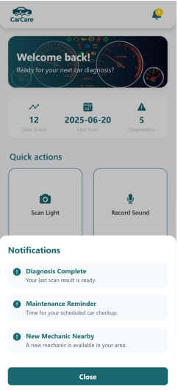
System Implementation & Testing
FrontEnd
TypeScipt + React Native for Android.
BackEnd
Node.js API coonected to MongoDB.
Testing
Funtional testing done; UI and Logic working Smoothly.

Slide 8
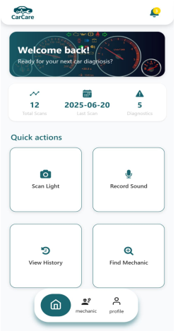



Summary of Work Done
Camera based dashboard detection & mic based engine sound analysis
Providing immediate and clear feedback to users
Step-by-step instructions, AI recommend tutorial videos and fixes
Mechanic profiles and Location Services

Slide 9
Conclusion
The CarCare project offers a promising, innovative solution to common vehicle diagnostic challenges faced by car owners, while also supporting mechanics in expanding their services. With further development and research, it has the potential to significantly impact automotive maintenance practices and contribute to safer, more efficient vehicle ownership
Thanks

Slide 10
Demo

